Slide 1
EECS 498 System Design of a Search Engine
Winter 2026
Lecture 18: Sitemaps and Shingles
Nicole Hamilton
https://web.eecs.umich.edu/~nham/
nham@umich.edu

Slide 2
agenda
details
tee shirts
finish ranking
sitemaps
shingles
instrumenting memory usage
exception handling.

Slide 3
agenda
details
tee shirts
finish ranking
sitemaps
shingles
instrumenting memory usage
exception handling.

Slide 4
details
This is the last technical lecture.
Lab this week will be discussion of team strategies.
Team presentations and demos.
    Thursday April 16 (4 weeks left!)
    Friday April 17
    Tuesday April 21 (last day of class)
Team meetings April 22 to April 28.
Final Exam April 29, 4:00 pm.

Slide 5
agenda
details
tee shirts
finish ranking
sitemaps
shingles
instrumenting memory usage
exception handling.

Slide 6


Orders will open tomorrow, stay open until next week.
Price will be $25. We should get them two weeks later.

Slide 7
agenda
details
tee shirts
finish ranking
sitemaps
shingles
instrumenting memory usage
exception handling.

Slide 8
basic strategy
Choose rarest word as an anchor and advance that ISR through each occurrence in the document.
At each occurrence of the rarest word, advance the other ISRs to position them as close as possible to the desired position in the flattened list.
Requires only one stage of look-ahead.

Slide 9
spans
If there is at least one occurrence of each query term, that’s a “span” which can be further distinguished as ordered, short, an exact phrase, etc.
Only the rarest word is guaranteed to a unique occurrence.
The other words may be reused.
Also count doubles and triples, meaning various combinations of just 2 or 3 of the words in the query, one of which must be the rarest.
Parameterized threshold for short vs. long spans, frequent vs. infrequent, etc.
Most features are binary and either occur or do not occur unambiguously.

Slide 10
Example phrase query "quick brown fox".
What I did was pick the rarest word and then arrange the other ISRs to as close as possible to their desired locations in the query relative to each occurrence of the rarest word.
Word counts:
quick 10
brown 14
fox 7
This reduces the number of combinations to be scored in this example from 10*14*7 = 957 to 7 and can be done a single pass with a single stage of lookahead.
Call each combination a span.
quick
62
69
84
311
421
430
559
619
794
952
brown
83
94
170
179
216
227
400
417
422
516
795
826
828
957
fox
284
423
580
612
796
912
958

Slide 11
Example phrase query "quick brown fox".
Iterate over the rarest word hits, arranging the other ISRs to as close as they could be to their desired locations in the query. Here are the first 3 spans.
brown
83
94
170
179
216
227
400
417
422
516
795
826
828
957
brown
83
94
170
179
216
227
400
417
422
516
795
826
828
957
brown
83
94
170
179
216
227
400
417
422
516
795
826
828
957
quick
62
69
84
311
421
430
559
619
794
952
quick
62
69
84
311
421
430
559
619
794
952
quick
62
69
84
311
421
430
559
619
794
952
fox
284
423
580
612
796
912
958
fox
284
423
580
612
796
912
958
fox
284
423
580
612
796
912
958

Slide 12
Example phrase query "quick brown fox".
For each combination, decide if it's an exact phrase or all the words in order, or close together, incrementing an associated counter. Shown here, there is one exact phrase but none of the rest are in order or particularly close together.
brown
83
94
170
179
216
227
400
417
422
516
795
826
828
957
brown
83
94
170
179
216
227
400
417
422
516
795
826
828
957
brown
83
94
170
179
216
227
400
417
422
516
795
826
828
957
quick
62
69
84
311
421
430
559
619
794
952
quick
62
69
84
311
421
430
559
619
794
952
quick
62
69
84
311
421
430
559
619
794
952
fox
284
423
580
612
796
912
958
fox
284
423
580
612
796
912
958
fox
284
423
580
612
796
912
958

Slide 13
Example phrase query "quick brown fox".
brown
83
94
170
179
216
227
400
417
422
516
795
826
828
957
brown
83
94
170
179
216
227
400
417
422
516
795
826
828
957
quick
62
69
84
311
421
430
559
619
794
952
brown
83
94
170
179
216
227
400
417
422
516
795
826
828
957
quick
62
69
84
311
421
430
559
619
794
952
quick
62
69
84
311
421
430
559
619
794
952
fox
284
423
580
612
796
912
958
fox
284
423
580
612
796
912
958
fox
284
423
580
612
796
912
958

Slide 14
Example phrase query "quick brown fox".
brown
83
94
170
179
216
227
400
417
422
516
795
826
828
957
This last one is close together (say, less than 10 words apart) and in order but it's not an exact phrase.
quick
62
69
84
311
421
430
559
619
794
952
fox
284
423
580
612
796
912
958

Slide 15
Example phrase query "quick brown fox".
brown
83
94
170
179
216
227
400
417
422
516
795
826
828
957
Set some thresholds and accumulate some counts, which can be scored at the end.
Thresholds Values
Max to be short 10
Min to be frequent ?
Min to be most ?
Min to be near the top ?
Heuristic Count Weight Score
Number of short spans 1 5 5
Number of in order spans 1 2 2
Exact phrases 2 10 20
Number of spans near the top ? ? ?
All word are frequent ? ? ?
Most words are frequent ? ? ?
Some words are frequent ? ? ?
Total dynamic rank score ?
quick
62
69
84
311
421
430
559
619
794
952
fox
284
423
580
612
796
912
958

Slide 16
Example phrase query "quick brown fox".
brown
83
94
170
179
216
227
400
417
422
516
795
826
828
957
One reason to decorate words as anchor, URL, title or body is so they can be separated in to separate streams (separate sets of ISRs) and scored separately with the same algorithm but different scoring parameters.
quick
62
69
84
311
421
430
559
619
794
952
Stream Weight Score
Anchor ? ?
URL ? ?
Title ? ?
Body ? ?
Total dynamic rank score ?
fox
284
423
580
612
796
912
958
Each of the streams can start at location 1 relative to the start of the document. The document length is the length of the longest stream.
Not all streams may contain all the words.

Slide 17
Example phrase query "quick brown fox".
brown
83
94
170
179
216
227
400
417
422
516
795
826
828
957
We do a similar heuristic calculation of the static rank, the quality of the page independent of the query.
Heuristic Weight Score
Short title ? ?
Nice document length ? ?
Short URL ? ?
Lots of anchor text ? ?
edu/gov/com/etc domain ? ?
PageRank if known ? ?
Total static rank score ?
quick
62
69
84
311
421
430
559
619
794
952
fox
284
423
580
612
796
912
958

Slide 18
Example phrase query "quick brown fox".
brown
83
94
170
179
216
227
400
417
422
516
795
826
828
957
Combine static and dynamic rank to get a final score.
Component Weight Score
Static rank ? ?
Dynamic rank ? ?
Total rank score ?
quick
62
69
84
311
421
430
559
619
794
952
fox
284
423
580
612
796
912
958
The result is a linear combination of features. We're just adding them up.
You should be able to achieve reasonably good results with a reasonably small number of heuristics and simple hand-tuning starting from some rough guesses at, e.g., the relative importance of an exact phrase versus lots of individual hits.

Slide 19
The actual score is calculated as a linear combination of features, which may be thought of as:
R = Σ Ci( Q ) * Ai( P, Fi ) * Si( Fi )
Where:
R = Overall Rank
Q = The Query and its characteristics, e.g., the number of rare vs. common words in the query.
P = The Page and its characteristics, e.g., the number of words in the URL or title.
Fi = An arbitrary feature observation, e.g., an exact phrase in the title, or a raw value, e.g., raw PageRank.
Si = Scaling for feature Fi from the raw number space of the feature into a nominal 0.0 .. 1.0 range.
Ai = Attribute scaling for feature Fi, possibly dependent on the characteristics of the page P.
Ci = Coefficient for feature Fi, depending on the characteristics of the query Q.
Fi = Ei( Q, P, T )

Slide 20
steps to ranking
Decide what information to collect and how to measure it.
Decide how to measure the quality of the result.
Pick a method for scoring a page based on the inputs.
Tune the system by testing it on sample queries and adjusting parameters, collecting more information or changing the scoring algorithm.

Slide 21
measuring quality
At Microsoft, initially, I just ran queries and eyeballed the results and fiddled with the parameters.
Results were surprisingly good.

Slide 22
measuring quality
We were also collecting labeled pages. We scraped queries and results from several engines and then paid people to rate results on a 0 to 5 scale.
5 Definitive result. Unlikely any other page could be a better result for this query, e.g., whitehouse.gov for "whitehouse".
:
0 Completely deleterious result, e.g., porno, spam, phishing.
This is similar to what Google is doing with their Page Quality Rating Guidelines, creating specificity in the ratings.
Altogether, I think we had about 50K queries and about 150K labeled results.

Slide 23
measuring quality
Next came a tool allowing us to do side-by-side comparison of results with current best parameters in a frame on the left and with a set you could tweak on the right.
If the pages had been labeled, it reported the quality and attempted to score the resulting set.
We ran a competition to see who could come up with the best settings.

Slide 24
measuring quality
Finally, we added a tuner that could adjust the parameters mechanically by gradient descent: Tweak an individual parameter rerun all the searches and measure whether the results got better (more highly ranked pages for each query.)
But we had lots of problems in the methodology of what to do with unlabeled pages.

Slide 25
measuring quality
Initially unlabeled pages were assumed to be “average”. Later, a “promising proximity” heuristic was added to the tuner bump the estimate for unlabeled pages if the search words were found close together.
The effect was to tune my complex ranker to behave like the tuner’s naïve ranker.
Better strategy would have been to only tune based on labeled results, discarding any unlabeled results or construct an index that only contained labeled pages.

Slide 26
generating labeled results
You can’t afford to pay people to label results but you might assume that Google is pretty good, so you might simply try to get pages in the same order as Google.
Your ranker won’t be as good as Google’s, so it might not be able to discern the difference between the top results on the first page, but perhaps it could distinguish between results on the first page and results on the tenth page.

Slide 27
strategy
Create a list of popular short queries.
Scrape Google for first 10 pages of results and label them.
Create an index of only those pages.
Make some initial estimates of the weights of your heuristics.
While you’re still making progress:
  Run each query and count how many you got right.
  Iterate over each heuristic, adjusting it up or down a little to see if there’s any improvement.
  Pick the best as a new starting point.

Slide 28
remarks
It is much easier to tune weights for binary features than for those encoding a range of “goodness”.
It is difficult to estimate the improvement you’ll get from a new feature without actually building it. A lot of it is intuition.

Slide 29
remarks
Think about what “blindspot” is created by not having the new proposed features.
When would the ranker not be able to tell the difference between two pages it should be able to distinguish?
How egregious would that be and how often would it occur?
What is your ranker getting wrong right now and would a simple heuristic fix it?
This kind of thinking led us to add features like “exact match” for the title.

Slide 30
remarks
Mechanically tuned parameter weights can be counter-intuitive if some of your heuristics overlap.
You can get a negative weight for something that should be good because it overlaps with something better.
The importance of anchor text made Googlebombs possible (and at Microsoft, we checked that they worked on our engine, too.)

Slide 31
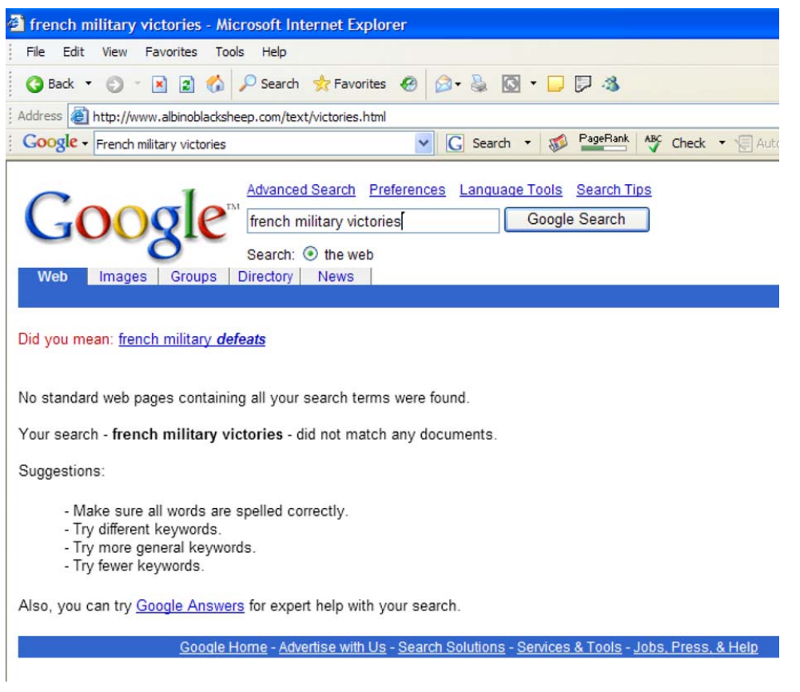

Slide 32
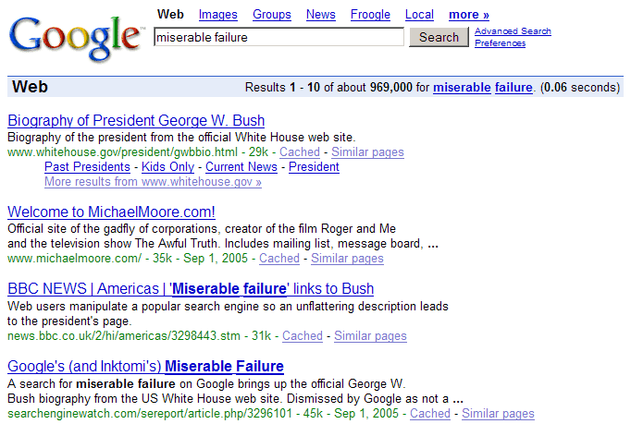

Slide 33
how to do better
To do better than heuristics, you will probably need a neural network.

Slide 34
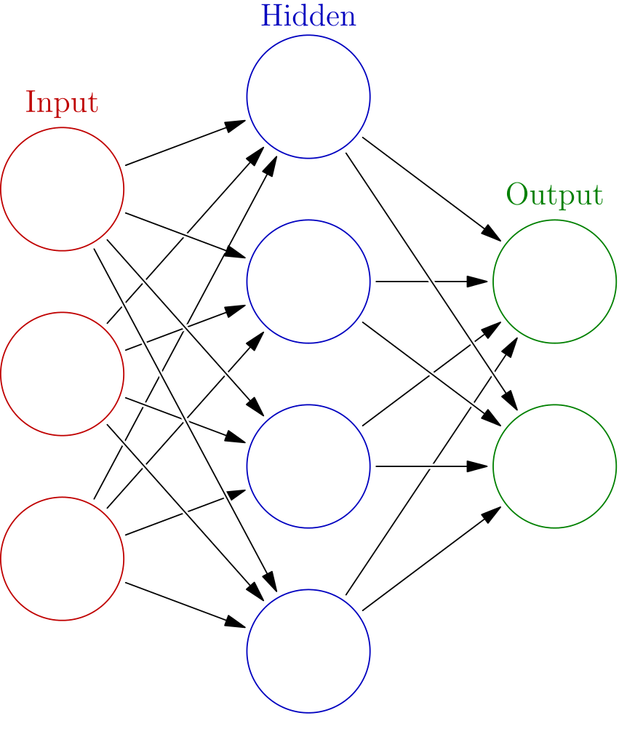
Example phrase query "quick brown fox".
A machine learning strategy would be to simply collect all the lists and pass everything to a neural network, which must be trained. Beyond the scope here.
quick
62
69
84
311
421
430
559
619
794
952
brown
83
94
170
179
216
227
400
417
422
516
795
826
828
957
fox
284
423
580
612
796
912
958
Image source: https://en.wikipedia.org/wiki/Artificial_neural_network

Slide 35
agenda
details
tee shirts
finish ranking
sitemaps
shingles
instrumenting memory usage
exception handling.

Slide 36
sitemaps
A sitemap is a file that lists all important pages, videos, and files on a website, acting as a roadmap for search engines to find, crawl, and index content efficiently.

Slide 37
sitemap format
The Sitemap protocol format consists of XML tags. All data values in a Sitemap must be entity-escaped. The file itself must be UTF-8 encoded.
The Sitemap must:
Begin with an opening <urlset> tag and end with a closing </urlset> tag.
Specify the namespace (protocol standard) within the <urlset> tag.
Include a <url> entry for each URL, as a parent XML tag.
Include a <loc> child entry for each <url> parent tag.
All other tags are optional.
Also, all URLs in a Sitemap must be from a single host, such as www.example.com or store.example.com.

Slide 38
Character |  | Escape Code
Ampersand | & | &amp;
Single Quote | ' | &apos;
Double Quote | " | &quot;
Greater Than | > | &gt;
Less Than | < | &lt;
Attribute |  | Description
<urlset> | required | Encapsulates the file and references the current protocol standard.
<url> | required | Parent tag for each URL entry. The remaining tags are children of this tag.
<loc> | required | URL of the page. This URL must begin with the protocol (such as http) and end with a trailing slash, if your web server requires it. This value must be less than 2,048 characters.
<lastmod> | optional | The date of last modification of the page. This date should be in W3C Datetime format. This format allows you to omit the time portion, if desired, and use YYYY-MM-DD.
<changefreq> | optional | How frequently the page is likely to change. Valid values are: always, hourly, daily, weekly, monthly, yearly never.
<priority> | optional | The priority of this URL relative to other URLs on your site. Valid values range from 0.0 to 1.0. This value does not affect how your pages are compared to pages on other sites—it only lets the search engines know which pages you deem most important for the crawlers. The default priority of a page is 0.5

Slide 39
Example sitemap
<?xml version="1.0" encoding="UTF-8"?>
<urlset xmlns="http://www.sitemaps.org/schemas/sitemap/0.9">
<url>
<loc>http://www.example.com/</loc>
<lastmod>2005-01-01</lastmod>
<changefreq>monthly</changefreq>
<priority>0.8</priority>
</url>
<url>
<loc>http://www.example.com/catalog?item=12&amp;desc=vacation_hawaii</loc>
<changefreq>weekly</changefreq>
</url>
<url>
<loc>http://www.example.com/catalog?item=73&amp;desc=vacation_new_zealand</loc>
<lastmod>2004-12-23</lastmod>
<changefreq>weekly</changefreq>
</url>
<url>
<loc>http://www.example.com/catalog?item=74&amp;desc=vacation_newfoundland</loc>
<lastmod>2004-12-23T18:00:15+00:00</lastmod>
<priority>0.3</priority>
</url>
<url>
<loc>http://www.example.com/catalog?item=83&amp;desc=vacation_usa</loc>
<lastmod>2004-11-23</lastmod>
</url>
</urlset>

Slide 40
A sitemap may also list other sitemaps
<?xml version="1.0" encoding="UTF-8"?>
<sitemapindex xmlns="http://www.sitemaps.org/schemas/sitemap/0.9">
<sitemap>
<loc>http://www.example.com/sitemap1.xml.gz</loc>
<lastmod>2004-10-01T18:23:17+00:00</lastmod>
</sitemap>
<sitemap>
<loc>http://www.example.com/sitemap2.xml.gz</loc>
<lastmod>2005-01-01</lastmod>
</sitemap>
</sitemapindex>

Slide 41
agenda
details
tee shirts
finish ranking
sitemaps
shingles
instrumenting memory usage
exception handling.

Slide 42
basic problem
The web is full of duplicate content.
What you don’t want in a search engine is for the top 10 results to all be the same page.
Very easy to identify exact duplicates by comparing checksums, e.g., CRCs, of the files.
But most of the duplicates are only near duplicates, e.g., a last modified date.

Slide 43
straightforward algorithm
Hash of a document
  Hash("It grows in dry places...") = 8d2f908...
When crawling a new document
  Compute hash
  Look up in hash table
    If present, it's a duplicate
    If not, put in the hash table
How many comparisons for N web pages?
  O(N) = O(N) lookups at O(1) per lookup

Slide 44
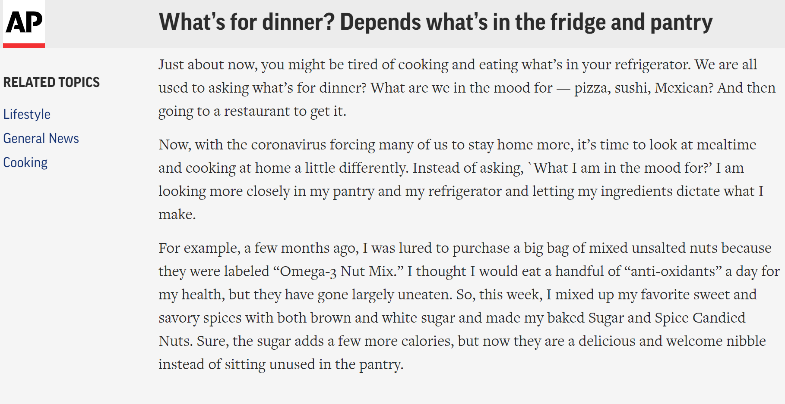
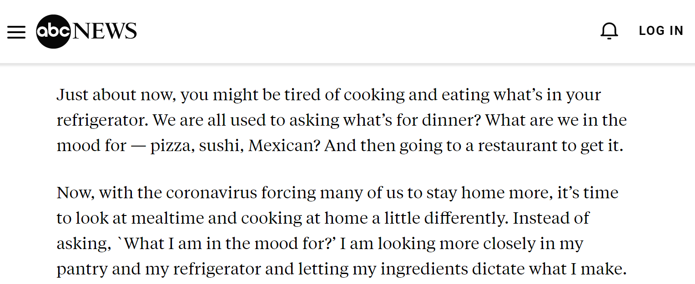
why not compare entire document?
Documents can be similar but not exactly the same

Slide 45
stripping “chrome”
One strategy is to try to strip out “chrome”, e.g., HTML tags, headers, footers and sidebars.
But still a question of how to quantify similarity.

Slide 46
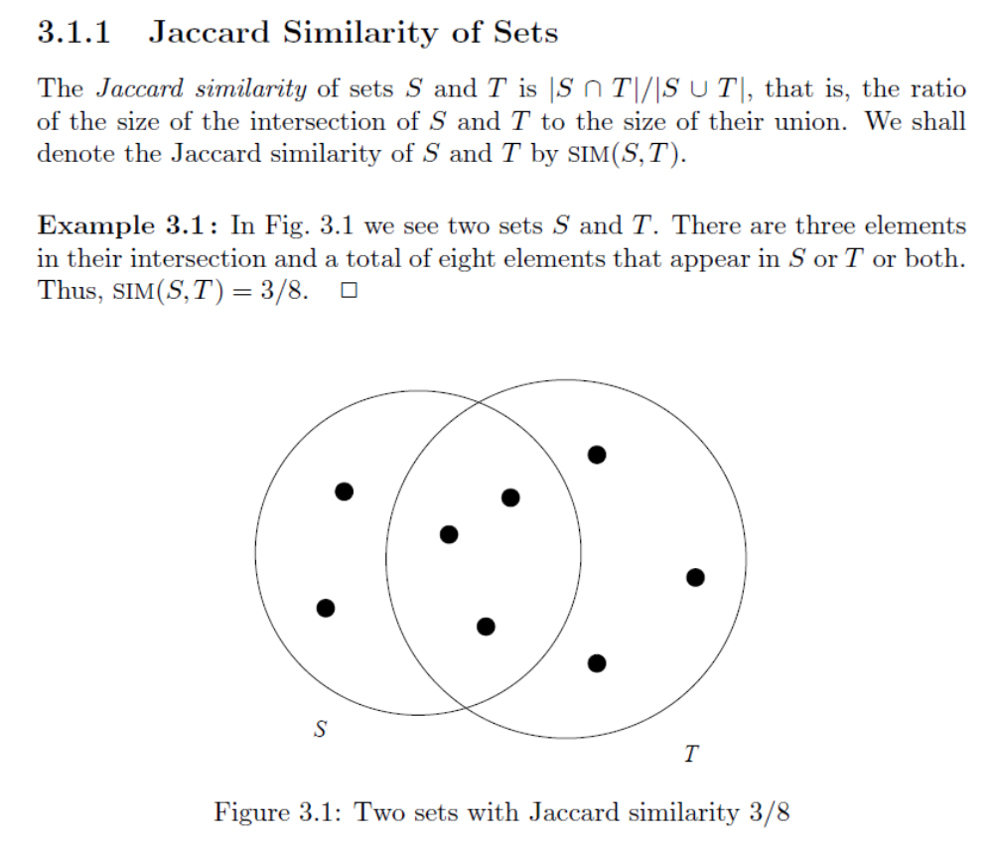
Source: http://infolab.stanford.edu/~ullman/mmds/ch3.pdf

Slide 47
k-Shingles
Consider a document as a string of characters or words.
Define a k-shingle as any substring of length k found in the document.
Suppose our document D is the string abcdabd, and we pick k = 2. Then the set of 2-shingles for D is {ab, bc, cd, da, bd}.

Slide 48
picking shingle size
k can be any constant you like.
If it’s too small, then most sequences will appear in most documents, creating false positives.
k should be large enough that the probability of any given shingle appearing in any given document is low.
k often chosen between 5 and 9 words or perhaps 25 to 50 characters.

Slide 49
shingles are hashed
Shingles are then hashed.
Bits are transposed randomly in the same way for all hashes.
Smallest result is saved in a hash table.
To look for a duplicate, look for a match in the hash table.

Slide 50
Sec. 19.6
Document 1
2⁶⁴
Start with 64-bit f(shingles)
Permute on the number line
with π_{i}
Pick the min value
2⁶⁴
2⁶⁴
2⁶⁴

Slide 51
test if Doc1.Sketch[i] = Doc2.Sketch[i]
Sec. 19.6
Document 1
Document 2
2⁶⁴
2⁶⁴
2⁶⁴
2⁶⁴
2⁶⁴
2⁶⁴
A
2⁶⁴
B
2⁶⁴
Are these equal?
Test for 200 random permutations: π₁, π₂,… π₂₀₀

Slide 52
however…
Sec. 19.6
Document 1
Document 2
2⁶⁴
2⁶⁴
2⁶⁴
2⁶⁴
A
2⁶⁴
B
2⁶⁴
2⁶⁴
2⁶⁴
A = B iff the shingle with the MIN value in the union of Doc1 and Doc2 is common to both (i.e., lies in the intersection)
Claim: This happens with probability
Size_of_intersection / Size_of_union

Slide 53
observations
Transforms the problem from comparing various sizes of text to comparing 64-bit integers.
But it’s still largely heuristic because you still have to decide how big the shingles should be, whether to keep duplicates and how many shingles to keep for each document.
Unclear why there’s an advantage to doing “200 random permutations” (out of 64! = 1.27e+089 possible) of what are already basically random numbers representing the hashes of all the shingles.

Slide 54
to investigate
I’ve written and uploaded two C++ programs that can memory map a file and calculate a sorted list shingles for comparison.
LinuxShingle.cpp
WindowsShingle.cpp

Slide 55
10 C% WindowsShingle.exe
Usage: Shingle [-d] <shingleSize> <stepSize> <N> <filename>
-d Report duplicates. By default, only unique shingles arereported
shingleSize = number of characters in a shingle
shingleStep = how many characters to step from one shingle to next
N = number of shingles to report. If N = -1, all shingles reported
11 C%

Slide 56
11 C% wc -l LinuxGet{Url,Ssl}.cpp
188 LinuxGetUrl.cpp
225 LinuxGetSsl.cpp
413 total
12 C% diff !$ | head
diff LinuxGet{Url,Ssl}.cpp | head
1c1,3
< // Linux get URL utility that copies the HTTP page to stdout.
---
> // Linux SSL get SSL utility that copies the HTTPS page to stdout
> // using OpenSSL
>
3a6,17
> // Required for build under Cygwin:
> // openssl
> // libssl-devel
13 C% diff LinuxGet{Url,Ssl}.cpp | grep '^^[><]' | wc -l
55
14 C% @ union = 413
15 C% @ difference = 55
16 C% calc percentOverlap = (union - difference)/union
0.866828
18 C%

Slide 57
101 C% WindowsShingle.exe 25 5 10 linuxGetUrl.cpp
118989564705677488
118993962752190332
130609402609293028
130703960609319174
168981396494694060
177539890157274494
184314166939961877
186826603892655687
195933926610954092
220539590904835157
102 C%

Slide 58
103 C% WindowsShingle.exe 25 5 10 linuxGetSsl.cpp
40923561173765480
60529522094422068
118989564705677488
118993962752190332
130609402609293028
168981396494694060
177539890157274494
184314166939961877
220539590904835157
236557822413782588
104 C%

Slide 59
7 out of 10 shingles are shared.
104 C% set a = LinuxGetUrl.cpp
105 C% set b = LinuxGetSsl.cpp
106 C% WindowsShingle.exe 25 5 10 $a > $a.shingle
107 C% WindowsShingle.exe 25 5 10 $b > $b.shingle
108 C% di {$a,$b}.shingle
40923561173765480
60529522094422068
118989564705677488
118993962752190332
130609402609293028
130703960609319174
168981396494694060
177539890157274494
184314166939961877
186826603892655687
195933926610954092
220539590904835157
236557822413782588
109 C%

Slide 60
Use a script to compare diffs and shingles.
110 C% similarity.csh 25 5 10 LinuxGet{Url,Ssl}.cpp
a = LinuxGetSsl.cpp
b = LinuxGetUrl.cpp
25 5 10
diffunion = 413
diffintersection = 358
diffsimilarity = 86.682809
shingleunion = 20
shingleintersection = 14
shinglesimilarity = 70
111 C%

Slide 61
Too small a number of shingles can generate a false match.
123 C% similarity.csh 25 1 1 LinuxGetUrl.cpp LinuxTinyServer.cpp
a = LinuxTinyServer.cpp
b = LinuxGetUrl.cpp
25 1 1
diffunion = 475
diffintersection = 96
diffsimilarity = 20.210526
shingleunion = 2
shingleintersection = 2
shinglesimilarity = 100
124 C%

Slide 62
Tune the heuristics.
124 C% similarity.csh 25 5 50 LinuxGetUrl.cpp LinuxTinyServer.cpp
a = LinuxTinyServer.cpp
b = LinuxGetUrl.cpp
25 5 50
diffunion = 475
diffintersection = 96
diffsimilarity = 20.210526
shingleunion = 100
shingleintersection = 22
shinglesimilarity = 22
125 C%

Slide 63
Tune the heuristics.
125 C% similarity.csh 25 5 50 LinuxGetUrl.cpp LinuxWcMap.cpp
a = LinuxWcMap.cpp
b = LinuxGetUrl.cpp
25 5 50
diffunion = 260
diffintersection = 33
diffsimilarity = 12.692308
shingleunion = 100
shingleintersection = 8
shinglesimilarity = 8
126 C%

Slide 64
agenda
details
tee shirts
finish ranking
sitemaps
shingles
instrumenting memory usage
exception handling.

Slide 65
instrumenting memory usage
Sometimes, you would like to know about your own memory usage.
How many objects do you have on the heap, total size, etc.
Problem is to intercept the new and delete operators.
Yes, you can do that.

Slide 66
// Toy program to investigate how memory is used by the STL
// string class.
#include <iostream>
#include <string>
#include <cstdlib>
using namespace std;
// Instrument new and delete by overriding the new and delete
// operators (yes, you can do that!) with a wrapper around malloc
// and free, adding a boundary tag to record the size of the memory
// request.
// total reflects the net total amount requested by the user and
// does not include any boundary-tagging overhead.
size_t total;

Slide 67
void *operator new( size_t size )
{
total += size;
size_t *q = ( size_t * )malloc( size + sizeof( size_t ) ),
*p = q + 1;
*q = size;
cout << size << " bytes allocated at " << p <<
", total = " << total << endl;
return ( void *)p;
}
void operator delete( void *p )
{
size_t *q = ( size_t * )p - 1;
total -= *q;
cout << *q << " bytes freed at " << p <<
", total = " << total << endl;
free( ( void * )q );
};

Slide 68
int main( )
{
cout << "1. starting total on the heap = " << total << endl;
cout << " putting a string on the stack" << endl << endl;
string p;
cout << endl << "2. sizeof an empty string on the stack = " <<
sizeof( p ) << endl;
cout << " total on the heap = " << total << endl << endl;
cout << "3. about to new an empty string" << endl << endl;
string *s = new string( );
cout << endl << "4. empty string has been allocated, total = " <<
total << endl << endl;
*s = "hello";
cout << endl << "5. string has been set it to hello, total = " <<
total << endl << endl;

Slide 69
*s += " world how are you i am fine";
cout << endl << "6. added 28 chars, total = " << total <<
", about to c_str" << endl << endl;
cout << "cstr = " << s->c_str( ) << endl;
cout << endl << "7. about to delete" << endl << endl;
delete s;
cout << endl << "8. string has been deleting, exiting total = " <<
total << endl;
}

Slide 70
51 C% Debug\sizestring.exe | head -20
1. starting total on the heap = 0
putting a string on the stack
8 bytes allocated at 00A2FD34, total = 8
2. sizeof an empty string on the stack = 28
total on the heap = 8
3. about to new an empty string
28 bytes allocated at 00A259AC, total = 36
8 bytes allocated at 00A2FE84, total = 44
4. empty string has been allocated, total = 44
5. string has been set it to hello, total = 44
48 bytes allocated at 00A256A4, total = 92
52 C%

Slide 71
agenda
details
tee shirts
finish ranking
sitemaps
shingles
instrumenting memory usage
exception handling.

Slide 72
Failing gracefully
If you're writing a serious application you intend to ship to customers, you have to anticipate it will fail in their hands.
If it does, it should fail gracefully reporting what happened, freeing up any resources, leaving files in a consistent state, capturing debug information, etc.

Slide 73
Exceptions
Two meanings:
In C++, it's something you throw, then catch higher up the call stack. You can't catch anything you didn't throw.
To the operating system, it's a hardware interrupt due to a null pointer deref (a seg fault), a floating point exception, ^C typed at the keyboard, etc.

Slide 74
#include <iostream>
#include <string>
using namespace std;
int main( int argc, char **argv )
{
string s;
while ( cin >> s )
{
try
{
cout << "stoi( " << s << " ) = " << stoi( s ) << endl;
}
catch ( invalid_argument )
{
cout << "stoi( " << s << " ) is invalid" << endl;
}
catch ( out_of_range )
{
cout << "stoi( " << s << " ) is out of range" << endl;
}
}
}

Slide 75
198 C% cl /EHsc stoi.cpp
Microsoft (R) C/C++ Optimizing Compiler Version 19.11.25508.2 for x64
Copyright (C) Microsoft Corporation. All rights reserved.
stoi.cpp
Microsoft (R) Incremental Linker Version 14.11.25508.2
Copyright (C) Microsoft Corporation. All rights reserved.
/out:stoi.exe
stoi.obj
199 C% stoi.exe
5
stoi( 5 ) = 5
hello
stoi( hello ) is invalid
1241241241234123412341234123412341234
stoi( 1241241241234123412341234123412341234 ) is out of range
^Z

Slide 76
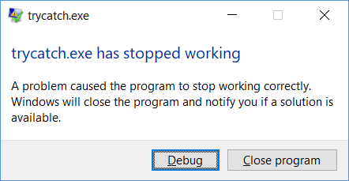
// trycatch.cpp
// Cannot catch a null pointer deref with C++ try/catch.
// Nicole Hamilton nham@umich.edu
#include <iostream>
#include <cassert>
#include <stdexcept>
using namespace std;
int main( void )
{
int *p = 0;
try
{
*p = 5;
}
catch ( ... )
{
cout << "Null pointer encountered" << endl;
}
}

Slide 77
// throw.cpp
// You could protect a possible null pointer deref
// with a test and a throw, but it's not realistic to do
// to all your derefs.
// Nicole Hamilton nham@umich.edu
#include <iostream>
using namespace std;

Slide 78
You could try to protect every pointer refer with a test and a throw, but that’s just not realistic.

Slide 79
int main( void )
{
int *p = 0;
struct NullPointerError
{
int **BadPointer;
NullPointerError( int **p )
{
BadPointer = p;
}
};
try
{
if ( !p )
throw NullPointerError( &p );
*p = 5;
}
catch ( NullPointerError &e )
{
cout << "Null pointer at " << e.BadPointer <<" encountered" << endl;
}
}

Slide 80
217 C% cl /EHsc throw.cpp
Microsoft (R) C/C++ Optimizing Compiler Version 19.11.25508.2 for x64
Copyright (C) Microsoft Corporation. All rights reserved.
throw.cpp
Microsoft (R) Incremental Linker Version 14.11.25508.2
Copyright (C) Microsoft Corporation. All rights reserved.
/out:throw.exe
throw.obj
218 C% throw
Null pointer at 00000033E5CFFE40 encountered
219 C%

Slide 81
You really need OS support.
This is the one area where Windows is better than Linux.
Windows added there own keywords, __try and __except, to the C++ language.

Slide 82
// tryexcept.cpp
// Simple Windows __try/__except example, intercepting
// a null pointer dereference using Microsoft try-except
// extension to C and C++. Compile with /EHsc.
// Choices for the __except filter expression value are:
//
// EXCEPTION_CONTINUE_EXECUTION = -1
// EXCEPTION_CONTINUE_SEARCH = 0
// EXCEPTION_EXECUTE_HANDLER = 1
// Nicole Hamilton nham@umich.edu
#include <windows.h>
#include <iostream>
#include <cassert>
#include <stdexcept>
using namespace std;

Slide 83
int main( void )
{
int *p = nullptr;
__try
{
*p = 5;
}
__except ( EXCEPTION_EXECUTE_HANDLER ) // Intercept anything
{
cout << "Null pointer dereference encountered" << endl;
}
}

Slide 84
175 C% cl /EHsc tryexcept.cpp
Microsoft (R) C/C++ Optimizing Compiler Version 19.11.25508.2 for x64
Copyright (C) Microsoft Corporation. All rights reserved.
tryexcept.cpp
Microsoft (R) Incremental Linker Version 14.11.25508.2
Copyright (C) Microsoft Corporation. All rights reserved.
/out:tryexcept.exe
tryexcept.obj
176 C% tryexcept.exe
Null pointer dereference encountered
177 C%

Slide 85
Windows can also give you additional information about the exception.

Slide 86
// tryexceptfilter.cpp
// A second Windows try/except example, intercepting
// a null pointer dereference using Microsoft try-except
// extension to C and C++ with an exception filter.
//
// Must be compiled with Microsoft Visual C++ /EHsc options.
// Nicole Hamilton nham@umich.edu
#include <windows.h>
#include <iostream>
#include <cassert>
#include <stdexcept>
using namespace std;
int ExceptionFilter( DWORD exceptionCode,
EXCEPTION_POINTERS *exceptionPointers )
{
cerr << "Exception code = " << hex << exceptionCode << endl;
return EXCEPTION_EXECUTE_HANDLER;
}

Slide 87
int main( void )
{
// In this example, we'll filter the exception, using
// GetExceptionCode and GetExceptionInformation to
// retrieve information about what happened.
//
// GetExceptionCode and GetExceptioninformation can
// only be called from within the __except expression,
// not from a subroutine.
int *p = nullptr;
__try
{
*p = 5;
}
__except ( ExceptionFilter( GetExceptionCode( ),
GetExceptionInformation( ) ) )
{
cout << "Null pointer dereference encountered" << endl;
}
}

Slide 88
157 C% cl /EHsc tryexceptfilter.cpp
Microsoft (R) C/C++ Optimizing Compiler Version 19.11.25508.2 for x64
Copyright (C) Microsoft Corporation. All rights reserved.
tryexceptfilter.cpp
Microsoft (R) Incremental Linker Version 14.11.25508.2
Copyright (C) Microsoft Corporation. All rights reserved.
/out:tryexceptfilter.exe
tryexceptfilter.obj
158 C% tryexceptfilter.exe
Exception code = c0000005
Null pointer dereference encountered

Slide 89
Linux uses more complex “signal handler” model.
If invoked, the signal handler “long jumps” back to earlier place in your code, unwinding the stack.
But note! Destructors are not run on anything popped off the stack by long jump.

Slide 90
// LinuxSignalHandler.cpp
// Simple demonstration of how to use the Linux sigaction system call
// along with setjmp and longjmp to intercept a segfault (or any other
// exception.)
// Nicole Hamilton nham@umich.edu
#include <unistd.h>
#include <setjmp.h>
#include <string.h>
#include <iostream>
using namespace std;
bool errorEncountered = false;
jmp_buf longjmpBuffer;

Slide 91
void SignalHandler( int signal, siginfo_t *info, void *context )
{
cerr << "Signal " << signal << " encountered." << endl;
// Indicate that an error occurred so we don't go down
// the same path again when we return.
errorEncountered = true;
// longjmp back to just before we entered the block
// failed, returning the signal number.
longjmp( longjmpBuffer, signal );
}

Slide 92
int main( int argc, char **argv )
{
// Create a sigaction structure describing how we'd
// like to intercept signals.
struct sigaction action;
memset( &action, 0, sizeof( action ) );
action.sa_sigaction = SignalHandler;
action.sa_flags = SA_SIGINFO;
// Install the signal handler for seg faults. (We have
// do this for each signal we'd like to intercept.)
int sigactionResult = sigaction( SIGSEGV, &action, nullptr );
// Before entering suspect code, capture a convenient
// spot to return to. If we encounter an error, this
// is where we'll pop out again. (Think Groundhog Day
// or Butterfly Effect.)
//
// The first time we setjmp, it returns 0.
// But if we pop back out because of a longjmp,
// it'll be with the value passed in the longjmp.
int setjmpResult = setjmp( longjmpBuffer );

Slide 93
if ( setjmpResult == 0 )
{
// Trying for the first time.
cout << "About to do the nullptr deref." << endl;
int *p = nullptr;
*p = 5;
cout << "Never reached." << endl;
}
else
cout << "Failed, error = " << setjmpResult << endl;
}

Slide 94
181 C% g++ LinuxSignalHandler.cpp -o LinuxSignalHandler
182 C% LinuxSignalHandler.exe
About to do the nullptr deref.
Signal 11 encountered.
Failed, error = 11
183 C%

